Slide 1
6th Grade ela
Mrs. Finch

Slide 2
website
By visiting my website, you will have access to:
Class news
EOG preparation materials
Links to important websites
Resources and notes from class
The syllabus
Classroom routines and expectations
Contact me at afinch@tmsacademy.org with any questions or concerns.
Please check PowerSchool regularly and encourage your child to do the same.

Slide 3
6th Grade ela standards
Click on the yellow text to access a list of standards
Reading: Literature
​Reading: Informational Text
Writing
Speaking and Listening
Language

Slide 4
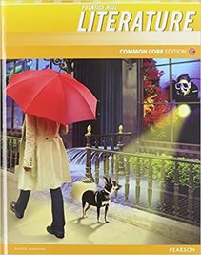
6th grade Literature textbook
Prentice Hall Literature: Grade 6
Online access
Pearsonsuccessnet.com
Students will bring home account information

Slide 5
Novel studies
We will read several novels this school year.
Students will be asked to purchase some of the novels (but not all) to practice the skill of annotating.

Slide 6
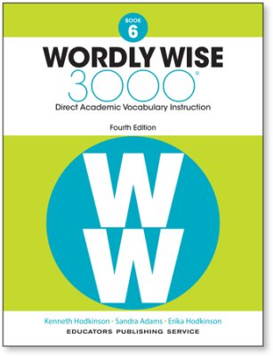
Vocabulary
Wordly Wise 3000 Book 6
In addition to reading the directions for each activity (A, B, C, D, and E), students should note the following guidelines:
Activity A: In addition to circling the two correct letters, you must write the full definition on the line. Be sure you spell the vocabulary word correctly!
Activity B: When filling in the vocabulary word, make sure you're using the correct tense if it's a verb. If it's a noun, consider whether it should be singular or plural.
Activity C: Choose the best answers.
Activity E: Use the UNWRAP strategies. If there isn't a bold word in the question, you must use a vocabulary word in the answer. Write in complete sentences.

Slide 7
Grammar
Prentice Hall 6th Grade Grammar Handbook

Slide 8
Scholastic and book it! program
To order books online, visit SCHOLASTIC.COM/READINGCLUB
Our classroom code is NG6YZ
We will be participating in Pizza Hut’s, Book It! Program
To participate, students should read 20 minutes per day
Record this information (Book It! Reading log)
At the end of the month, students can turn in their reading logs in class and receive a free personal pizza coupon from Pizza Hut

Slide 9
Communication
Email and PowerSchool are my primary sources of communication
Email: afinch@tmsacademy.org
PowerSchool
Upcoming due dates for tests, quizzes, homework assignments, etc.
Subject to change
Students should be using agenda to write down their homework
Missing work, late work, scores, grades can be viewed on PowerSchool

Slide 10
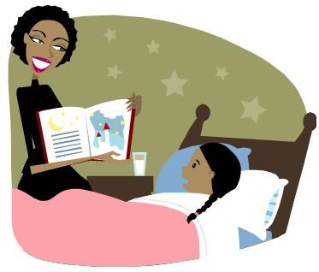
Reading at Home!
Reading at home is ESSENTIAL
Enjoy these tips from Scholastic for encouraging your middle-school student to read
The more students read, the better their comprehension will become!
“The Educational Testing Services reported that students who do more reading at home are better readers and have higher math scores” (National Education Association).
“The U.S. Department of Education⁵ found that, generally, the more students read for fun on their own time, the higher their reading scores” (National Education Association).

